Slide 1

What Makes For a Successful Airbnb Rental Property . . . in Hawaii?

Slide 2
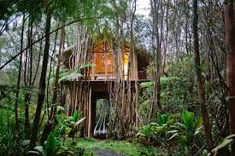
Data Source
Data source: The “Inside Airbnb” Project
http://insideairbnb.com/get-the-data.html
Data published under Creative Commons CC0 1.0 Universal (CC0 1.0) "Public Domain Dedication" license.
From insideairbnb.com’s disclaimers:
The data utilizes public information compiled from the Airbnb web-site … and the reviews for each listing.
No "private" information is being used. Names, photographs, listings and review details are all publicly displayed on the Airbnb site.
Data is verified, cleansed, analyzed and aggregated

